Slide 1
SiPass integrated MP2.76 SP1 Whats’s New! Matthew Bell
siemens.com/buildingtechnologies
Restricted © Siemens AG 2019

Slide 2
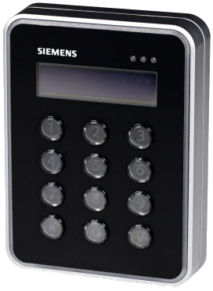
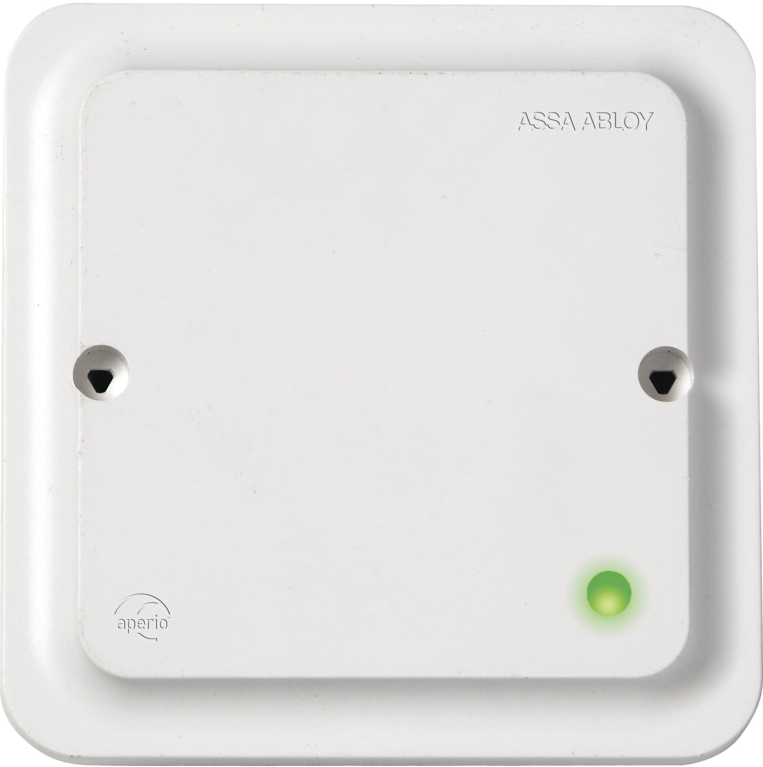
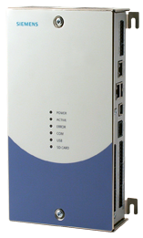
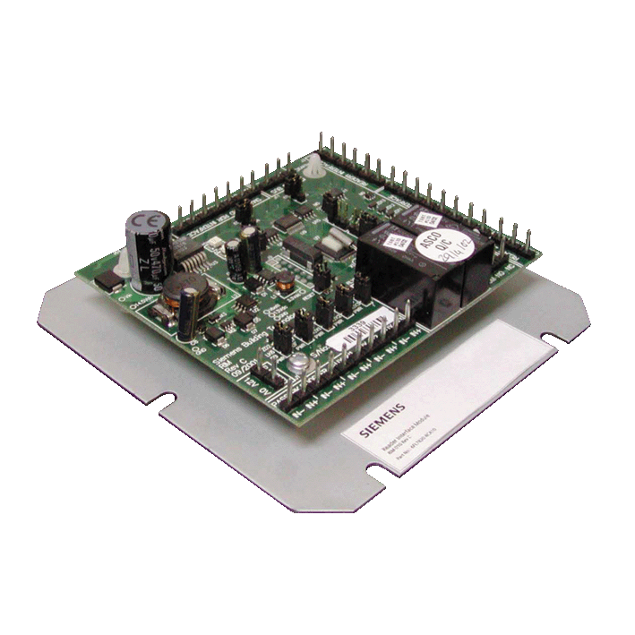
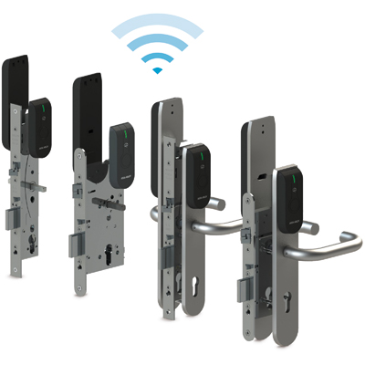
ACC-AP with APERIO Wireless Locks
Existing Hardware Options
ACC-AP
SiPass integrated Server
MULTIPLE HUBS
ACC G2
RS485
FLN RS485 Comms
DRI
Readers
APERIO E100 Wireless Locks

Slide 3
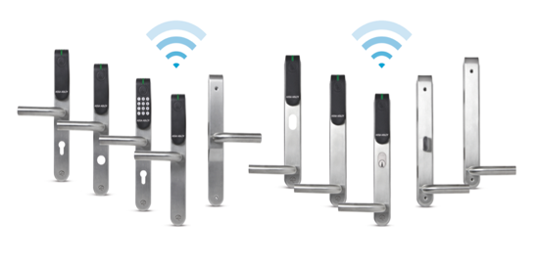
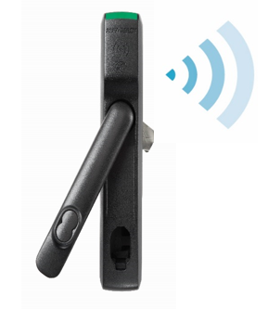
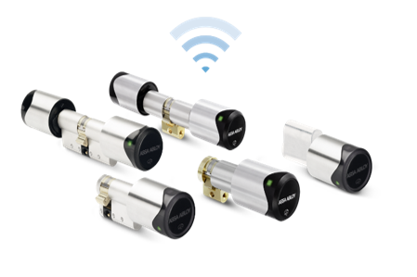
ACC-AP with APERIO Wireless Locks - Benefits
Designed to compliment the online access control offering
Up to 15 hubs with a total of 32 locks supported per ACC-AP
Real time* monitoring and control of the door status and lock
Wireless locking with power of an ACC
Venue Booking
Event tasks
Manual Control
Time Schedule control
Easy to install and commission
Fits existing access privilege management
*Actual response time is based on the polling intervals set during configuration. Increased poll time will have an effect on battery life.

Slide 4
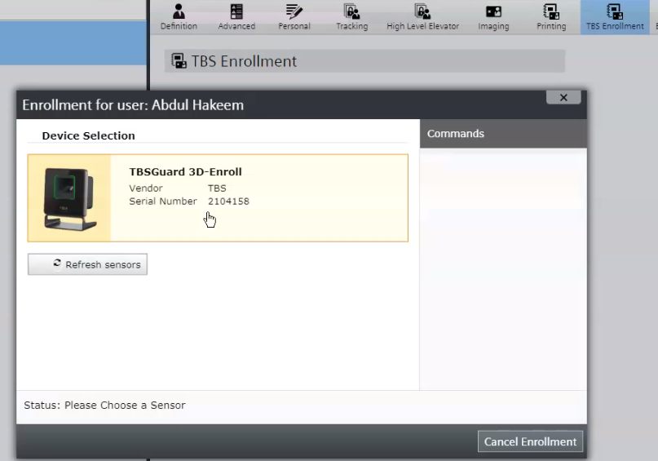
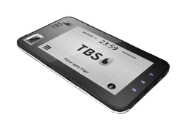
TBS Biometric Enrolment – Remote enrolment enabled
TBS is a trusted partner of Siemens and offers a comprehensive range of biometric technologies to suit almost any customer environment and requirements including
3D – Contactless
Multi-spectral Imaging
Optical
Capacitive
Portable
Face+Iris

Slide 5
ACC-AP with Wiegand Interface
ACC-AP
Wiegand support now added for legacy systems
Most existing Wiegand formats have been added
SiPass integrated Server
ACC G2
FLN RS485 Comms
DRI
Readers
2 x Wiegand interface

Slide 6
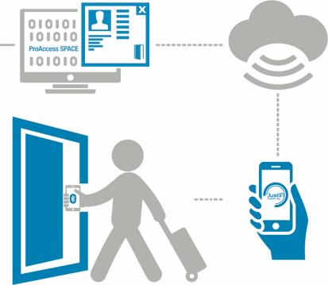
SALTO JustIN support
SiPass integrated Server
JustIN Mobile BLE allows doors to be opened with a smartphone
Users can receive mobile keys anytime and anywhere
Mobile number transferred from SiPass integrated during syncronisation
Mobile Key is sent OTA (Over The Air) to the Salto JustIN mobile app on the users registered and verified mobile phone

Slide 7
Thank you for your attention!
Matthew Bell Product Manager SiPass integrated BT CPS FS PLM DMS-EU (not for long)
Dammstrasse 21 6300 Zug, Switzerland
Mobile: +41798762100
E-mail: matthew.c.bell@siemens.com

